Slide 1
Image Compression
Domain :
SVD
Group 2 - Out_of_Bounds

Slide 2
TABLE OF CONTENTS
01
02
03
04
05
06
07
08
09
Background
Motivation
Problem Statement
Basic Mathematics
Literature Survey
Reproduced work
Plan of Action
Contribution
References

Slide 3
Background
Multimedia content of digital information is increasing day by day. Transfer and Storage of data should be efficient.
Image compression - reducing number of bits to represent data while maintaining acceptable image quality.
A popular technique called SVD (Singular Value Decomposition) is used to compress image.
The SVD was discovered over 100 years ago independently by Eugenio Beltrami (1835–1899) and Camille Jordan (1838–1921), James Joseph Sylvester (1814– 1897), Erhard Schmidt (1876–1959), and Hermann Weyl (1885–1955).
Image compression can be done using different lossy and lossless compression techniques.

Slide 4
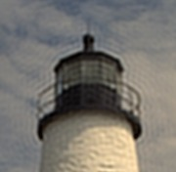
MOTIVATION
To accomplish image compression in more efficient way than other algorithms as:
Comparison speed is high
More stable
Allows us to perform optimization on memory reduction(unlike fourier transform)
Does not lead to the ringing and blocking
artifacts

Slide 5
Problem Statement
Compressing an image while keeping an appropriate balance between compression ratio and quality.

Slide 6
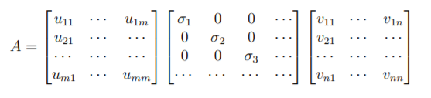
Basic Mathematics
Image Matrix A
decomposed into U, S and Vᵀ matrices with both U and V being orthogonal matrices and S is a diagonal matrix composed of singular values of A in decreasing order
Vᵀ
A
=
U
S
n x n
m x n
m x m
m x n

Slide 7


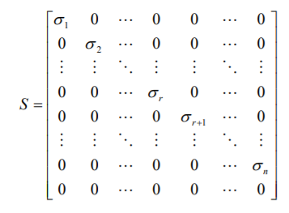

Basic Mathematics
Matrix U = [u₁, u₂, u₃ ,......, uₘ]
column vectors uᵢ , for i = 1, 2, …, m, form an orthonormal set:
Matrix V = [v₁, v₂, v₃ ,......, vₙ]
column vectors vᵢ , for i = 1, 2, …, n, form an orthonormal set:
Diagonal matrix S has singular values such that:
For i = 1, 2, …, σₙ
r = rank of matrix

Slide 8
Literature Survey

Slide 9
From research paper of Mrs. Rehna V.J and Mr. Abhranil Dasgupta,
Image Compression is done by removing these redundancies:
Coding redundancy
Spatial/Interpixel redundancy
Psychovisual redundancies-Irrelevant information (data that is ignored by the human visual)

Slide 10
Compression Ratio is the ratio of the storage space required to store original image to that required to store a compressed image and is given by
Compression Ratio = m*n / (k*(m+n+1))
The Eigenvectors of a square matrix are the non-zero vectors that change only in magnitude, not in direction.
SVD is lossy compression (compressing image but some information will be lost)
Lost information cannot be recovered

Slide 11
Properties of SVD
The singular value σ₁, σ₂, …, σₙ are unique, however, the matrices U and V are not unique.
As AᵀA = VSᵀSVᵀ, so V diagonalizes AᵀA, it follows that the vⱼ’s are the eigenvector of AᵀA.
As AAᵀ = USSᵀUᵀ , so it follows that U diagonalizes AAᵀ and that the uⱼ’s are the eigenvectors of AAᵀ.
If A has rank of r then vⱼ, vⱼ, …, vᵣ form an orthonormal basis for range space of Aᵀ, R(Aᵀ) and uⱼ, uⱼ, …, uᵣ form an orthonormal basis for range space A, R(A).
The rank of matrix A is equal to the number of its nonzero singular values

Slide 12



SVD methodology
While compressing the above sum is not performed till the very last term.
Instead sum is taken till first “k” term,

Slide 13
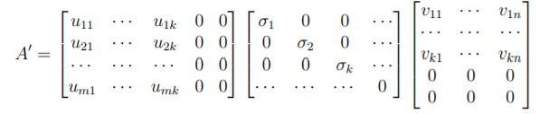
...
“k”
take the largest k elements along the diagonal and set others to 0.
set to 0 : columns in U and rows in Vᵀ with index larger than k.

Slide 14


...
Memory
Compression Ratio
Mean Square Error (MSE)
Original Image= m x n
Compressed Image= k (m + n + 1)
U ( m x k )= mk values
Vᵀ ( n x k )= nk values
S ( k x k) = k values
Aᵢ= mk + nk + k
= k(m+n+1)
To measure the quality between original image and compressed image

Slide 15
From a research paper by Miss Samruddhi Kahu and Ms. Reena Rahate,
Lower singular values carrying no or little information can be eliminated without causing severe visual distortion.
Value of k(number of eigenvalues used to compress and reconstruct an image) is related to image quality and compression ratio.
Smaller k → higher compression ratio → more degradation in image and vice versa
For compressing image,
m*n > k*(m+n+1)

Slide 16
Reproduced Work
(taking into consideration of research papers mentioned in references)

Slide 17
Matlab Simulation
Image into grayscale format
Image data → matrix of each pixel (value 0-255)
Computation of SVD operations on matrix
Computation of errors and displaying error graph
Output as compressed images with different singular values taken at each time.

Slide 18
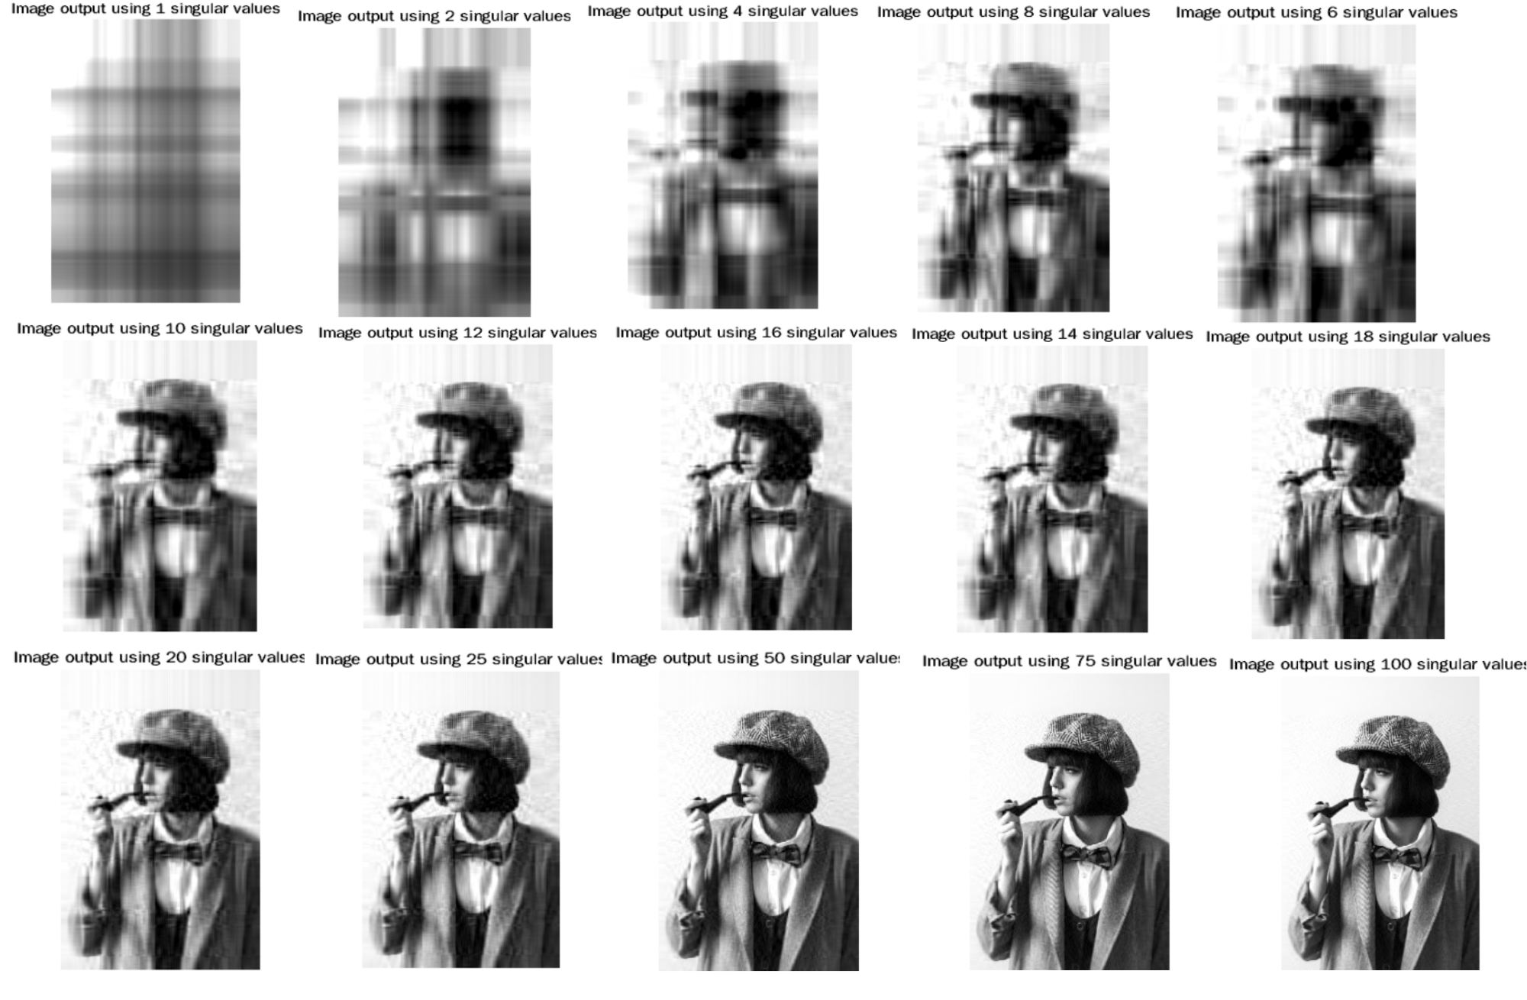
Compressed Images (different k values)

Slide 19
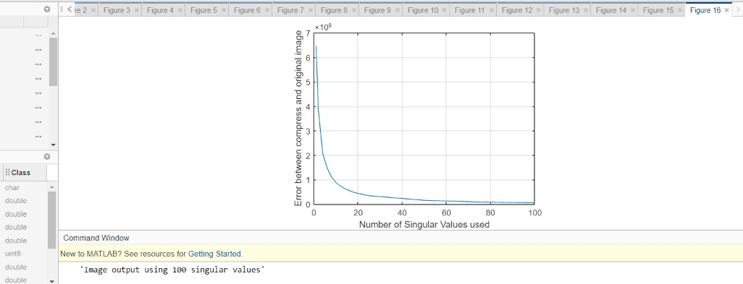
Graph
Error vs Number of singular values used

Slide 20
Plan of Action
Plan to code SVD compression in python using following steps:
Taking image as input and separating its RGB components
Calculating rank
Performing SVD on component matrices
Output :
Compressed image
Regenerating matrix components and combining them
Applying approximations and removing singularity

Slide 21
Matlab Simulation
Python code
Comparison
Optimum Compression
Simulation of grayscale images
For color images
Detailed comparison between compressed and original images
How to choose appropriate value of k

Slide 22
Contribution
Priya Jani
Priyanshu Pathak
Yansi Memdani
AU2040004
AU2040241
AU2040028
Research
Literature Survey
Documentation
Code
Presentation
Matlab Simulation
Code
Literature Survey
Research
Presentation
Background
Motivation
Research
Code
Presentation

Slide 23
References
1. Jameela, Rehna. (2011). JPEG Image Compression using Singular Value Decomposition. IOSR Journal of Electrical and Electronics Engineering. 1. 81 - 88.
2. Kahu, S. and Rahate, R., 2013. Image Compression using Singular Value Decomposition. [ebook] SciResPub., pp.244-248. Available at: <http://www.ijoart.org/docs/Image-Compression-using-Singular-Value-Decomposition.pdf> [Accessed 28 September 2021].
3.Singular value decomposition applied to digital image ... (n.d.). Retrieved October 20, 2021, from https://sites.math.washington.edu/~morrow/498_13/svdphoto.pdf.
4. Image compression using singular value ... - math. (n.d.). Retrieved October 20, 2021, from https://www.math.utah.edu/~goller/F15_M2270/BradyMathews_SVDImage.pdf.

Slide 24
THANK YOU

